Slide 1

By: Team Jiminy Cricket

Slide 2




Meet the Team
Charles Madere
Joseph Gautier
Jarrad Pinestraw
Geonathan Sena

Slide 3






Software Used

Slide 4
Browser Support
HTML5 features not supported universally
Focus mainly on Chrome
Also supporting: Firefox 7.0.1 and IE9

Slide 5

sdk
Originally: going to use facebook chat
Instead: create our own web-based chat app
Will still use facebook

Slide 6
Still To Do
Saving/exporting the drawn images
Basic sounds during certain events
Chat
Games!!

Slide 7
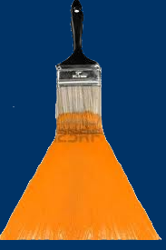
Now Take Out Your Paint Brushes
Here’s Our Prototype
www.wepaint.us

Slide 8
Questions?

